Slide 1

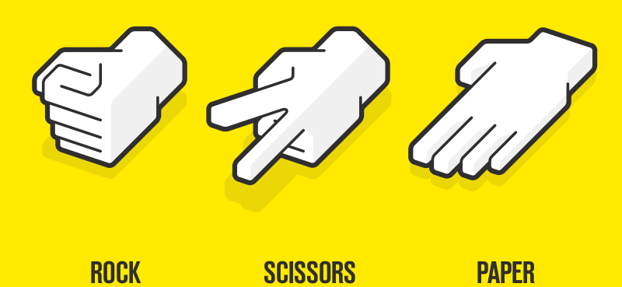
Rock-Paper-Scissors
Rock paper scissors is a hand game, usually played between two people.
Here you have a chance to play with your computer.
In this game, each player simultaneously forms one of three shapes with an outstretched hand.

Slide 2
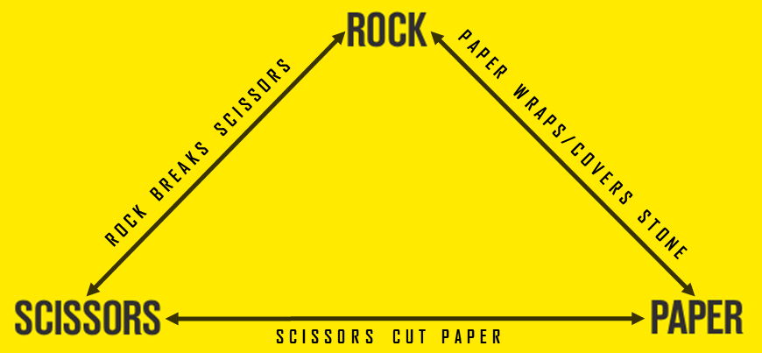
The Game logic
This game has one of the most simplest logic.
Either you win, lose or it is a tie.

Slide 3
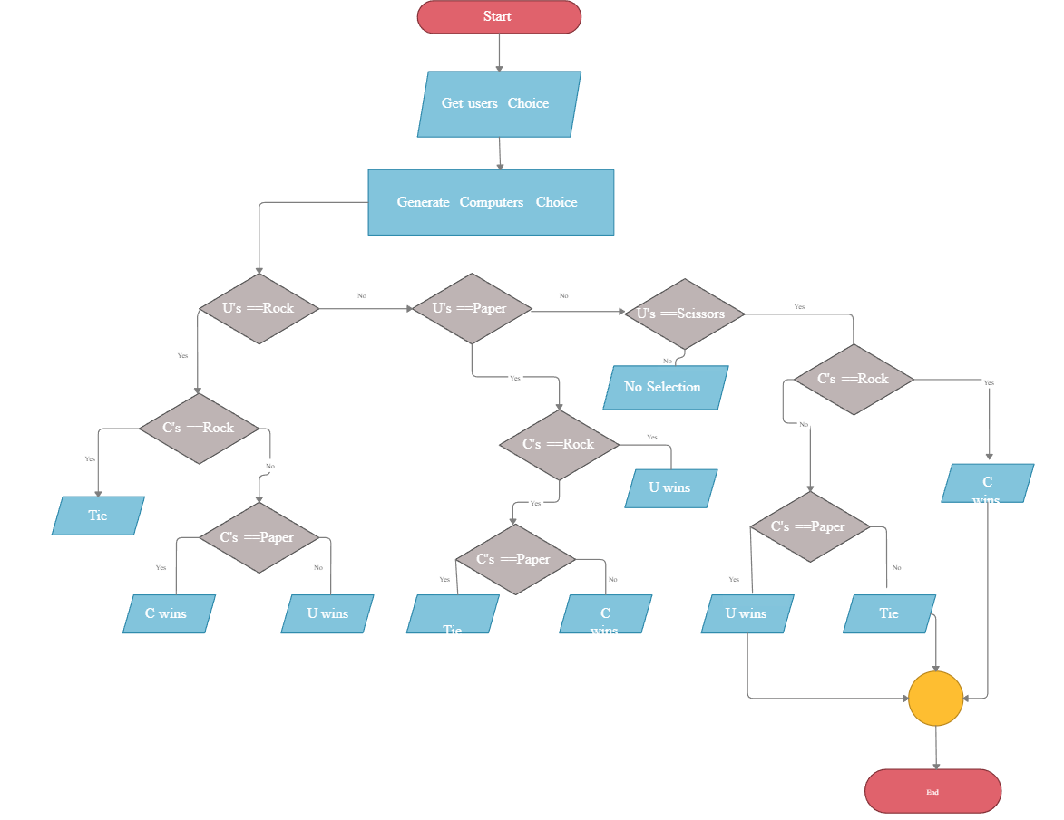
The Game logic

Slide 4


What did we use to make this game
We used the basic knowledge of python and also used a module named “Tkinter”.
Tkinter was used to develop the GUI(Graphical User interface) for the game.

Slide 5
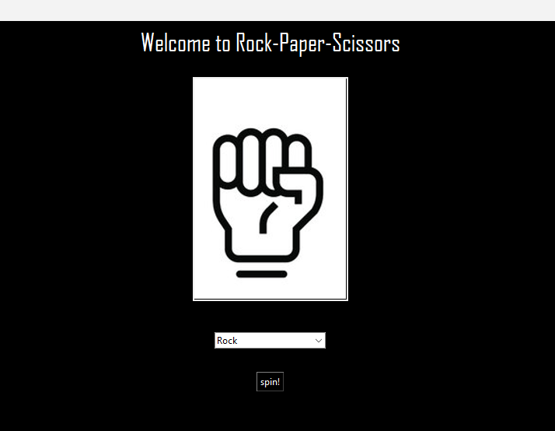
Easy to use UI(user interface)
Heading
Image of the object selected by the computer
Drop-down box for user to choose an option from
The button which changes the choice made by computer and prints whether the user won or lost or if it is a tie

Slide 6
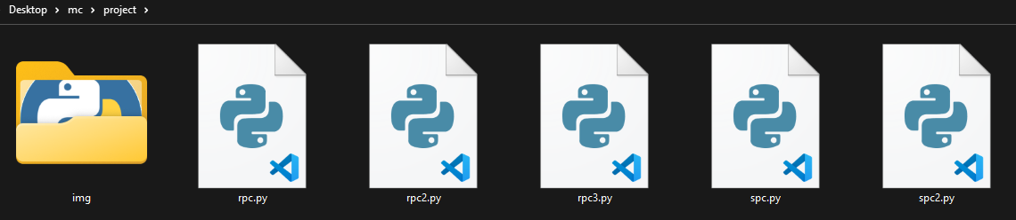
How to run the code
Let’s say the user downloaded the file with the name rps.zip and extracted it.
It will contain the py file along with an img folder.

Slide 7
How to run the code
Then the user needs to install the Tkinter module.
So open CMD
And type in the following command
Pip install tk
This will start downloading the Tkinter module

Slide 8

How to run the code
Once the installation is complete put in the directory/path in which user saved the py file
Then type in the command
python rpc.py

Slide 9
How to run the code
Then you will be welcomed to the rock-paper-scissors game

Slide 10
The End

